Slide 1
PGM Boundary conditions
Lateral concentrations at the boundary of 36km domain (36US) in the 2014 modeling platform are downscaled from 2014 GEOS-Chem global model
GEOS-chem model provided for 2014 has these features
Model version: v11-01
Spatial Resolution: horizontal – 4x5 degree, vertical – 47 layers
Temporal Resolution: 3-hourly, Spatial Coverage: (-147.5, 8) to (-52.5, 64)
Chemistry/Aerosol Options: SOA
CMAQ boundaries obtained with geos2cmaq tool
CAMx boundaries obtained with geos2camx tool

Slide 2
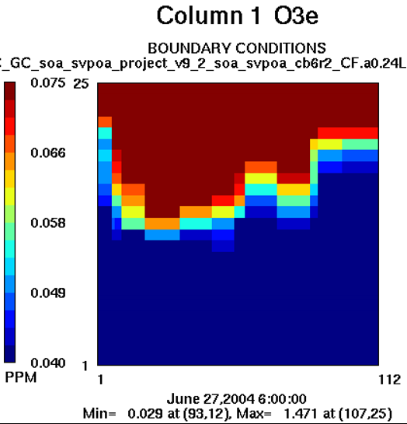
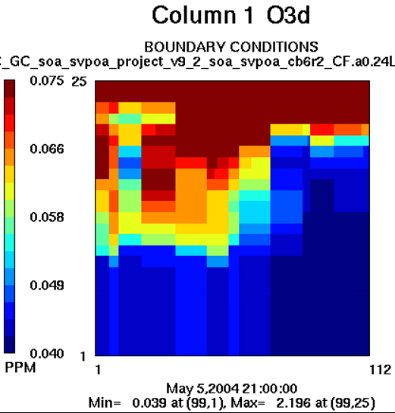
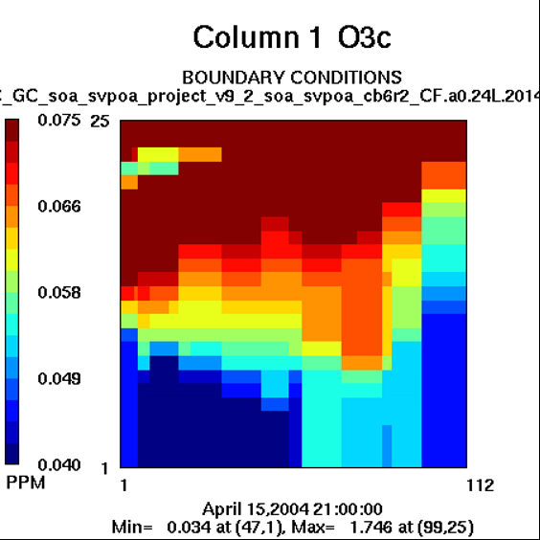
INITIAL extraction of GEOS-Chem concentrations
Ozone concentrations for January, April, August at upper layers show values over 2 ppm
January | April | August
Performed 36km inert tracer runs to investigate the BCON influence on surface concentrations for selected species: O3, dust (CCRS, FCRS), SO2, PSO4, sea salt (NA, PCl)

Slide 3
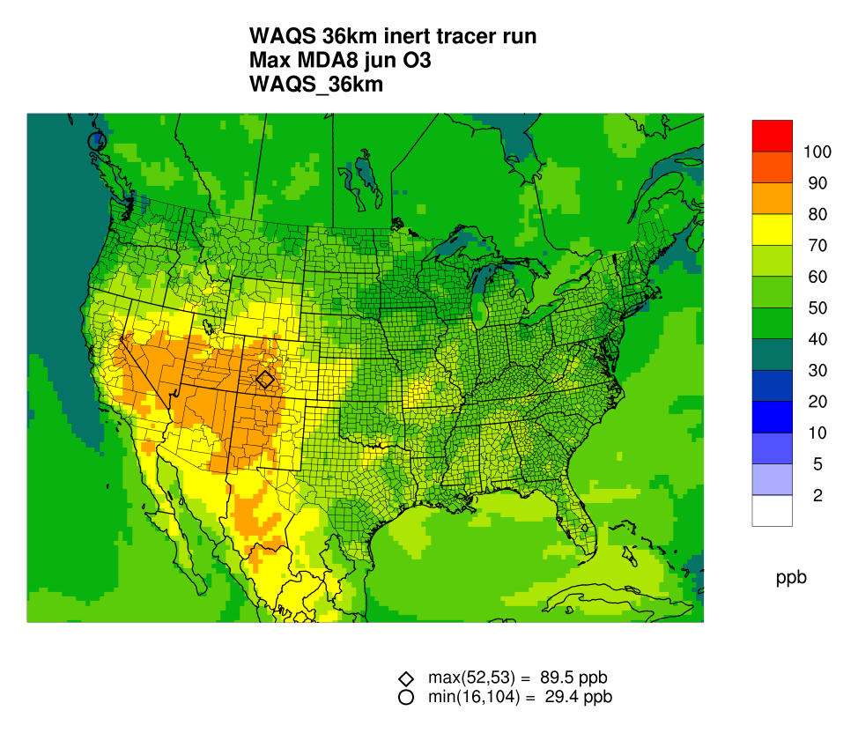
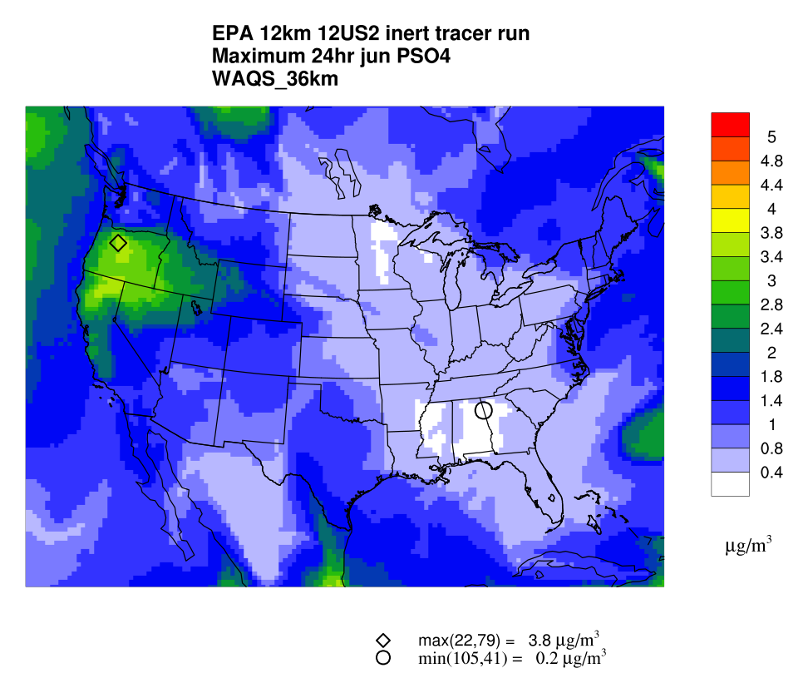
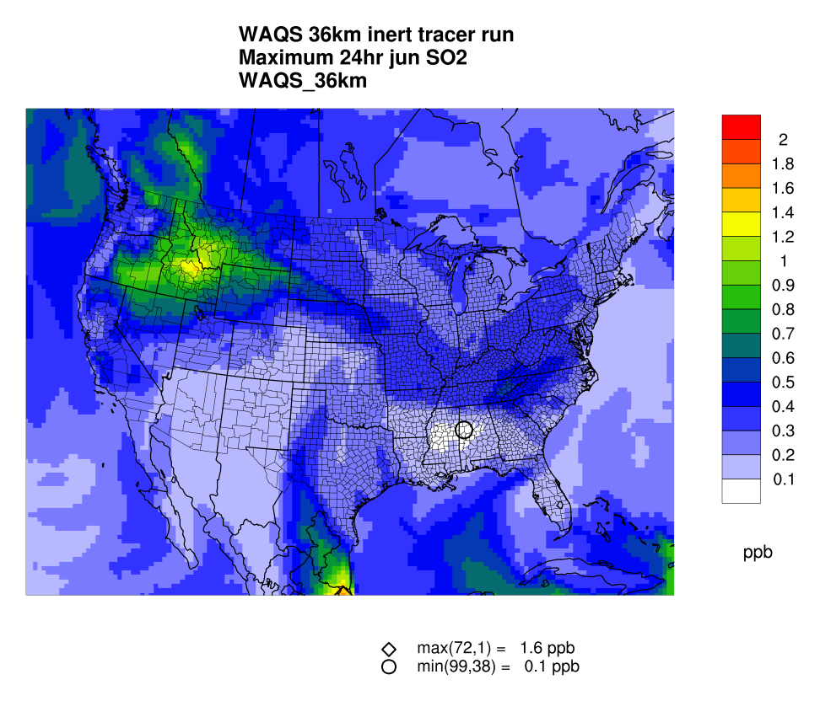
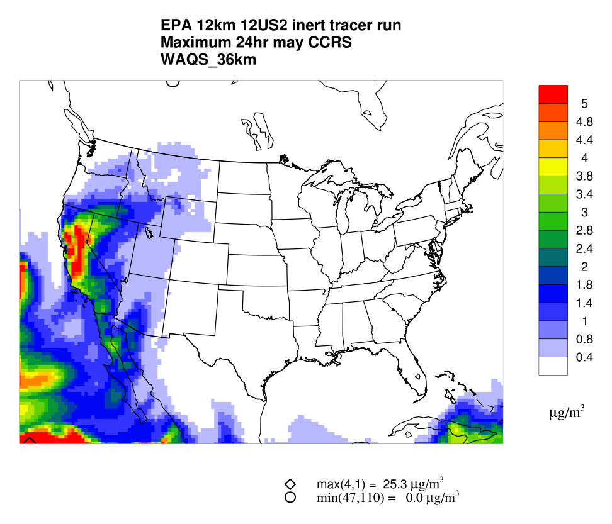
Initial Inert Tracer simulation results
MDA for ozone and daily max concentrations were estimated for sulfate, SO2, dust and sea salt
Ozone - June | PSO4 – June | SO2 - June | CCRS - May
Ozone tracer concentrations > 90 ppb in western US in the summer (June, July August)
Sulfate concentrations are ~ 4 μg/m³ in Northern CA, WA in June and July
SO₂ concentrations are ~ 2 ppb in Idaho in June
Dust (CCRS/FCRS) concentrations ~ 9.4 μg/m³ in Central CA
No issues with sea salt concentrations since they are low (Na and Cl < 1 μg/m³).

Slide 4
Adjustments to Boundary Concentrations
The initial tracer concentrations were adjusted (capped to a maximum value) after:
1) Comparing tracer concentrations to observed values from IMPROVE sites (SO4, dust)
2) Looking at the maximum values of these tracers from each of the boundaries (SO4, SO2, O3)
3) Cap values we have used in previous projects (O3)
Species | Adjustment
O3 | Cap values to <= 0.1 ppm
CCRS | No adjustment
FCRS | No adjustment
PSO4 | Cap values to <= 2 μg/m³
SO2 | Cap values to <= 0.006 ppm
NA, Cl | No adjustment

Slide 5
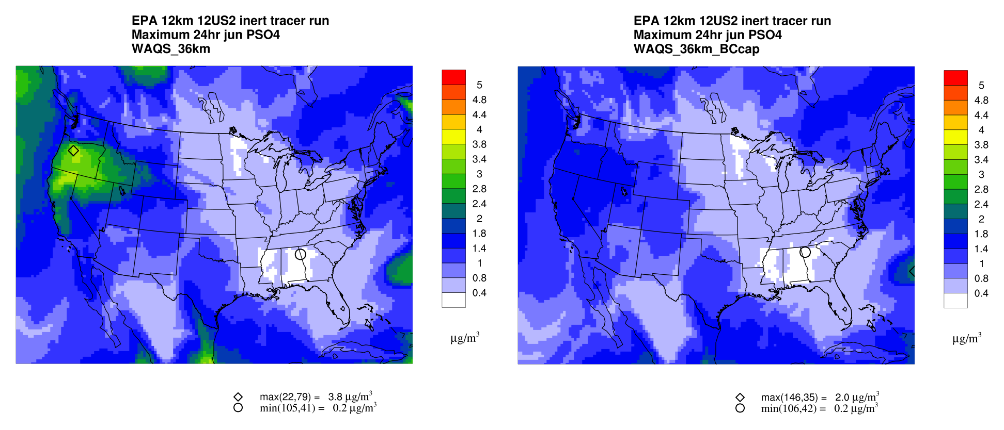
inert tracer simulation with Adjusted BCON
Sulfate adjustments correct high concentrations in CA and WA

Slide 6
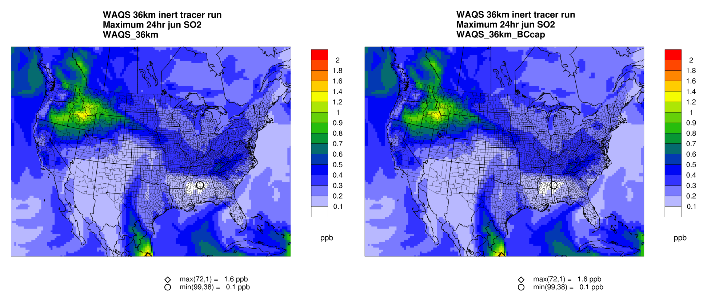
inert tracer simulation with Adjusted BCON
SO2 adjustments do not significantly change original inert tracer concentrations

Slide 7
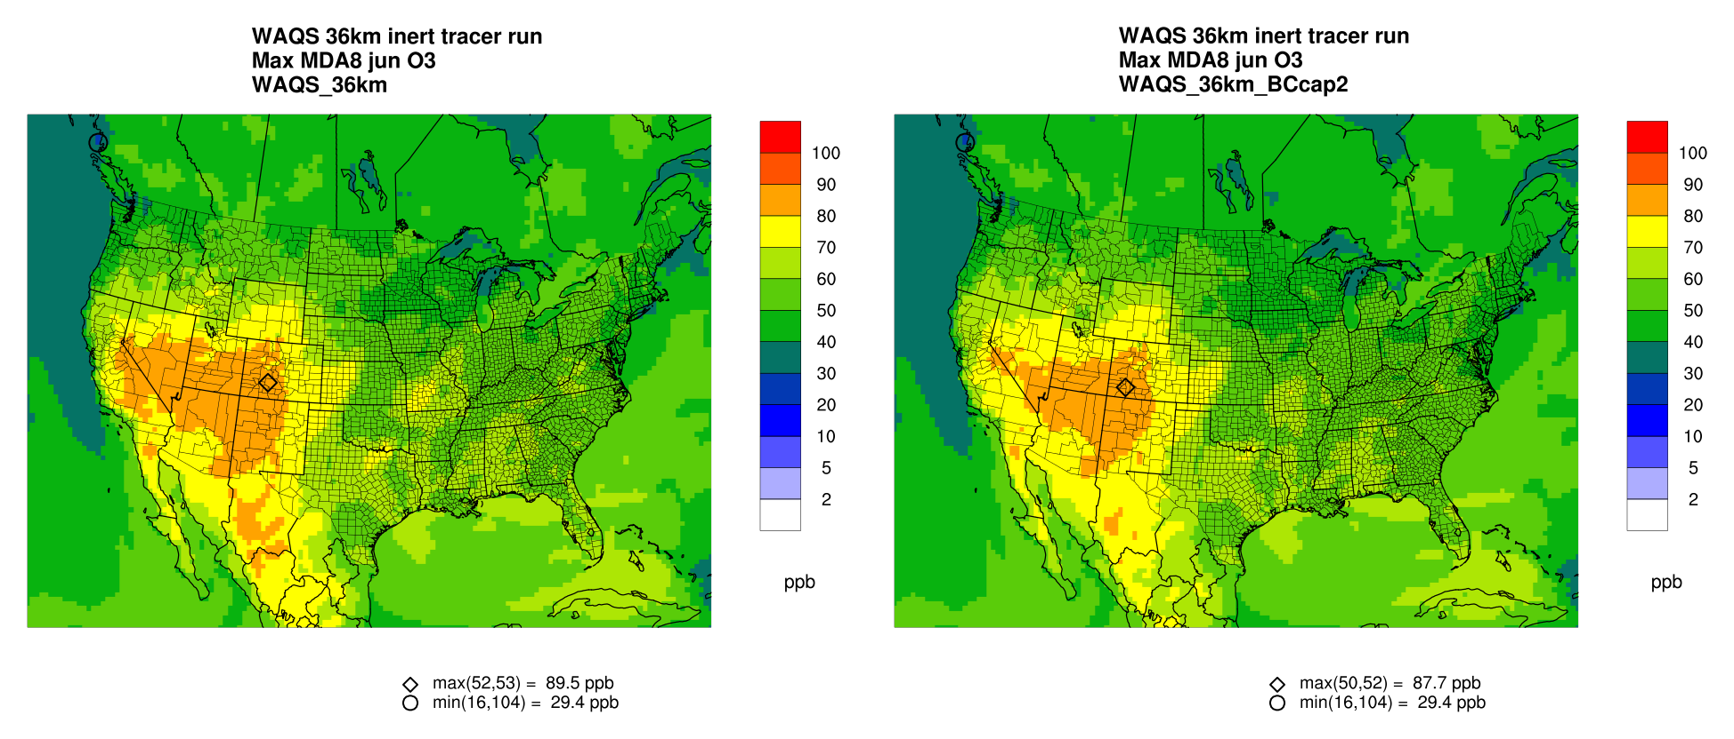
inert tracer simulation with Adjusted BCON
Ozone concentrations remain high in western US even with cap values of <= .1 ppm

Slide 8
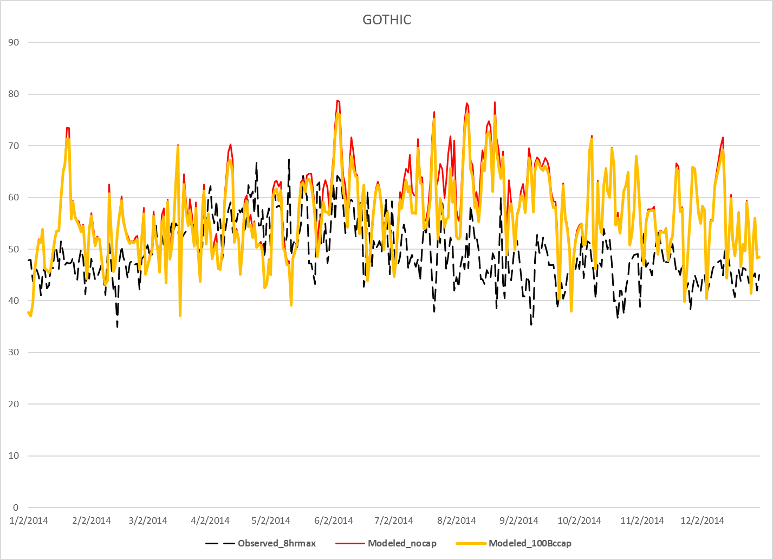
inert O3 tracer simulation with Adjusted BCON
Inert tracer compared to CASTNET observations at Gothic, CO consistently overpredicts values
Effect of the cap values is negligible at this site

Slide 9
Next Steps on BCs
Proceed with Task 6a Sensitivity and Task 6b Final 2014 Shake-Out CAMx and CMAQ 36/12-km runs using latest capped 2014 GEOS-Chem BCs
Ozone ≤ 0.100 ppm; SO4 ≤ 2.0 µg/m³; SO2 ≤ 0.006 ppm
In inert BC simulations ozone still much higher than observed (e.g., > 70 ppb) at high elevation sites in summer (e.g., Gothic)
Higher photochemical activity in summer may “chew up” and reduce BC ozone influence in full chemistry simulations alleviating the ozone overestimation from the inert BC runs
If full chemistry runs don’t alleviate summer ozone overestimation at high terrain sites, may need to conduct a July no layer collapsing sensitivity test
Can’t do before annual 2014 36/12-km annual CAMx and CMAQ Shake-Out runs

